Slide 1

How to … Manage your time
Time management and Organization

Slide 2
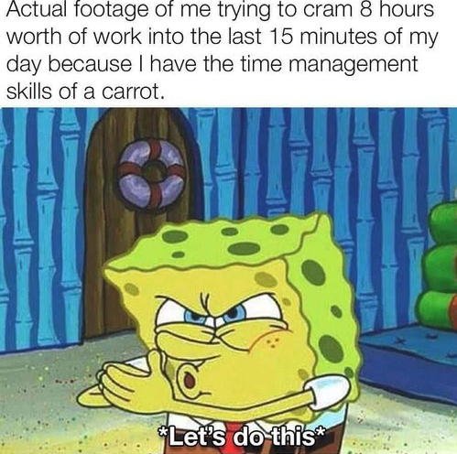
Why time management matters
It is important to optimize your efforts
We all have busy lives with things we need to do and things we want to do, and it's unlikely you have time to get everything you need and want to do done
Prioritization can help make sure you're getting the things you need to done instead of wasting time
Managing your time well can help with stress and anxiety because you are making strides toward doing what you need to do and not just thinking about everything in a stress spiral of doom
If you organize your time well it can help your work/life balance because you aren't wasting as much time worrying about your to-do list

Slide 3
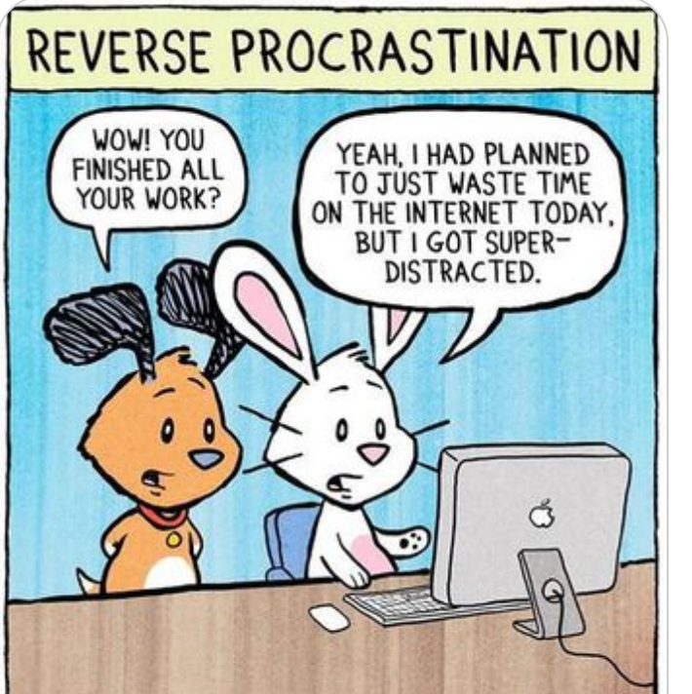
How to select something that works for you
You need to try anything that seems reasonable for time management suggestions or systems
There isn't a way to figure out if it works for you without trying, make sure you give the trial long enough that it gets past any initial excitement
However, make sure you have a reasonable trial period, (1 day to 1 week) and have something measurable to decide if it works
Try adding a check-in to your calendar to remind you that it's time to figure out if the method you selected is actually working
Think about the pros and cons while having an honest introspective look at yourself. If you know you are really bad at something don't pick a system that relies on that thing.
You are trying to reduce friction and get more done better, not be a different person
Don't just say "I'll try harder" that doesn't help anyone, try something different

Slide 4
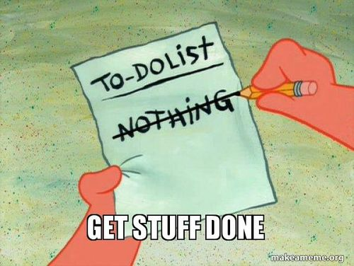
Getting things done (GTD)
A way to get things from your head to a list, so you don't waste brain power trying to remember everything
This system has 5 steps in the framework, Capture, Clarify, Organize, Reflect, Engage
Pros: Structured approach, good for not worrying about remembering everything since the to-do list is not an internal mental one
Cons: Large initial implementation time commitment, needs constant maintenance
WARNING: If you are a procrastinator, you can spend more time organizing than doing so this might not be a good system for you

Slide 5
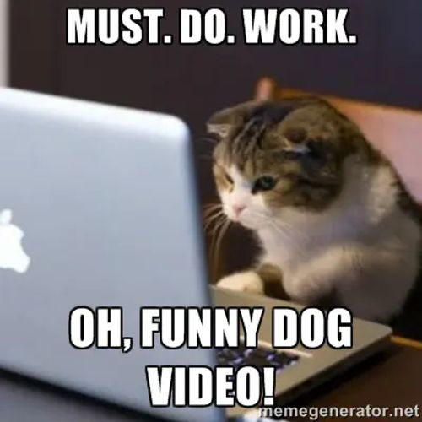
Pomodoro technique
Breaks everything down into timed intervals with short breaks
Timer is usually 25min of work, 5 min break, after every 4 intervals of work take a longer break
Designed to help focus on a task without interruptions taking advantage of attention spans
Pros: Focus and productivity is easier with a time limit, good for procrastinators, can help with burn out since there are regular breaks
Cons: Tough for teams or situations where interruptions are frequent, can interrupt a deep concentration, needs some discipline to stick to your timers
WARNING: If you tend to fall into focus for long periods of time to get your best work done, this will annoy the heck out of you

Slide 6
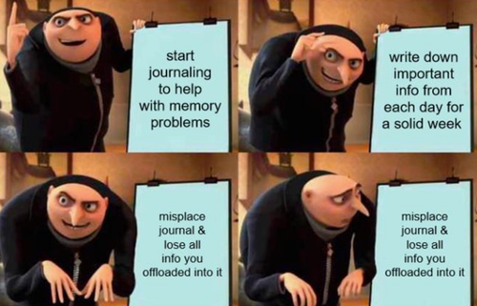
Bullet journal (BuJo)
This can be a physical or digital journal, this is a very flexible system
Some people like making them pretty, some don't care, do what works for you
The more official rules include things like an index, future log, monthly log and daily logs, but this can be done however you want
Pros: VERY customizable, allows creativity and the ability to make it work for you however you want
Cons: It can be easy to ignore your tasks, it's easy to fall into the trap of making it so pretty you do that instead of work
WARNING: if you like stationary this can be an expensive habit. Ask me how I know.

Slide 7
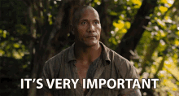
Most Important Thing (MIT)
Looks at the 1-3 most important tasks for the day
Pros: Doing the important or high impact stuff first can encourage you to do more, this can show clear progress, very specific high value stuff gets done
Cons: Prioritization shifts are an issue, your most important task might be too large to get done in the time you have, you may be in an environment where only getting 1-3 things done isn't enough
WARNING: Easy to do one thing, pat yourself on the back for job well done and then go back to your enjoyable thing of choice like video games instead of getting everything you need to done
Consider adapting this to work with other methods by using this to help prioritization in another time management technique

Slide 8
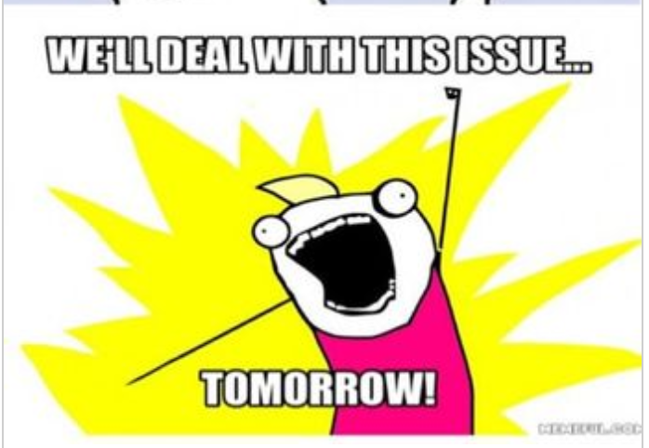
Calendars
You can use a calendar to block out due dates
You can use them to block out study time
One good use of a calendar is to plan out your day/week so you can see exactly what's going on with your time, if you feel like you have no time for anything you can record what you're doing to see where it's going
Make sure to include incidentals, so if you add in a work day, don't forget to include transit time
Taking care of yourself including hygiene, sleep and food are good to include on your plan, as well as some relaxation time
Make sure to give yourself some extra padding time if possible, such as over estimating how long work will take so you aren't stuck at the last minute

Slide 9
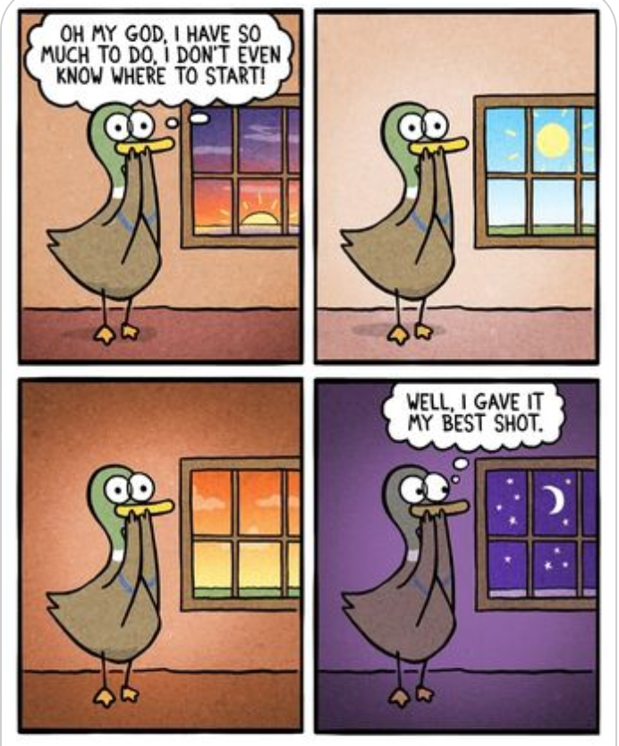
Software suggestions
For some people having an app or software to implement your time management strategy can be helpful
Kanban style boards
It's like a visual to-do list using cards for items, usually broken down into three categories, to do, in progress and done
Trello, Notion, and other kanban style applications
Calendar tools
Google, Samsung, Apple, or any other digital calendar
Any timer or clock, but separate apps can include reminders for breaks at appropriate intervals
You can also use software to help track what you're actually doing vs what you think you are doing to help you guess how long things take

Slide 10

Procrastination
Lie to yourself about deadlines
Set all due dates several hours/days in advance
Tell yourself there is no flexibility and everything is a firm deadline
Be careful you don't start thinking of all due dates as flexible, or get inured to them and miss something
Consider bribery
Reasonable small treats for completing things such as 10min of video games for every 30min of work done
Try setting up an easy thing to do before stopping for the day so you can jump right into something not difficult to help with the mental block of not knowing what to do
Be careful you don't fall down the rabbit hole of prioritizing organization over doing the actual thing you need to do

Slide 11
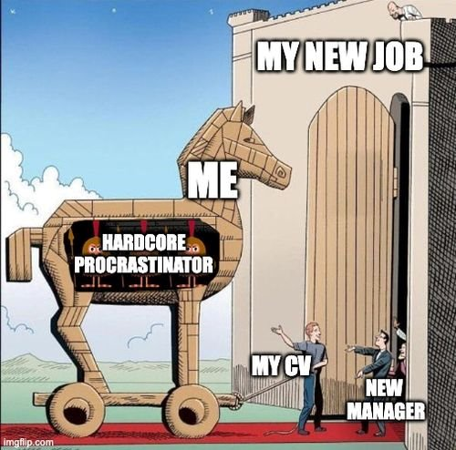
Other road blocks
How to help if you struggle with executive function
Suggestions if you have difficulty focusing
Check-ins with someone to hold yourself accountable and get your work done on time
No is a whole sentence. Think about your personal priorities and what is reasonable to say no to
Review your days/weeks so you can figure out if you're wasting time on unexpected things or spending more time on something than you think
Body Doubling
Consider music or audio books in the background (not new ones) things you're familiar with as a way to mimic body doubling

